Slide 1
Diwali sales analysis
CAPSTONE PROJECT
Presented By:
Ronit Saini – Manipal Institute of Technology- Computer Science

Slide 2
OUTLINE
Problem Statement
Proposed System/Solution
System Development Approach
Algorithm & Deployment
Result
Conclusion
References

Slide 3
Problem Statement
As the Diwali sales season approaches, a retail company aims to strategically boost sales by harnessing the power of data analysis. The challenge is to discern patterns in customer behavior, identify regional preferences, and pinpoint popular products. By delving into demographic insights, understanding geographical nuances, and evaluating product trends, we seek to uncover actionable strategies that can be implemented to not only meet but exceed customer expectations. The goal is to leverage this analysis to tailor marketing approaches, optimize inventory, and enhance overall sales strategies, thereby maximizing revenue and ensuring a successful Diwali sales period.

Slide 4
Proposed Solution
As we stand on the brink of the Diwali season, the challenge isn't just to celebrate the festivities but to strategically elevate our sales performance. The proposed solution I present today revolves around a meticulous data analysis framework. This journey is a structured approach, from data collection to actionable strategies, designed to unlock the full potential of our Diwali sales. Join me as we explore how demographic analyses, product insights, geographical nuances, and marketing strategies converge into a cohesive plan, offering us a pathway not just to sell but to excel during this festive season.
Step 1: Data Collection and Preprocessing:
The initial phase involves a robust data collection process, where we've acquired historical Diwali sales data from the provided dataset. This dataset encompasses critical information such as customer demographics, product categories, and regional details. To ensure data reliability, we've undertaken essential preprocessing steps, addressing missing values using dropna(), removing unrelated columns ('Status' and 'unnamed1') via drop(), and enhancing data accuracy by converting the 'Amount' column to integer type using astype('int').
Step 2: Demographic and Product Analysis:
Our analysis focuses on understanding customer behavior through demographic insights. The code explores customer distribution based on gender, age groups, marital status, and occupation. Visualizations, such as count plots and bar charts, provide a clear overview of the customer landscape. Further, we've delved into product analysis, identifying popular product categories and specific items. This step is crucial for tailoring marketing strategies and ensuring that promotional efforts align with the preferences of distinct customer segments.

Slide 5
Step 3: Geographical Analysis:
The code extends its reach to regional nuances by investigating the top states contributing to Diwali sales. Visualizations, including bar charts, depict the total number of orders and sales amounts from these states. This geographical analysis is instrumental in understanding regional variations and tailoring sales strategies based on location-specific trends.
Step 4: Marketing Insights and Recommendations:
Building on the demographic and product analyses, the code provides insights into effective marketing strategies. By analyzing the correlation between marital status, gender, and sales amounts, we gain valuable information for targeted marketing efforts. Additionally, exploring the most popular products and categories offers recommendations for potential business strategies. These insights can guide inventory management and promotional activities, maximizing the impact of marketing efforts during the Diwali sales period.
Step 5: Continuous Improvement:
Recognizing the dynamic nature of the retail landscape, the proposed solution emphasizes the importance of continuous improvement. Regularly updating the analysis with new data and incorporating external factors, such as real-time market trends or events, ensures that our strategies remain adaptable and aligned with evolving customer preferences. This iterative approach positions the business to stay agile and make informed decisions for optimizing Diwali sales over time.

Slide 6
System Approach
In developing the Strategic Diwali Sales Enhancement, a systematic approach is paramount. This encompasses defining the system requirements and outlining the necessary tools for effective implementation.
System Requirements:
Our system demands a robust data infrastructure, including a comprehensive dataset capturing diverse aspects of Diwali sales – from customer demographics to product categories. A reliable computing environment, ensuring seamless data processing and analysis, is crucial. Additionally, a user-friendly interface facilitating easy navigation and interpretation of results is essential for practical application. To execute the Diwali Sales Analysis code, your system should have at least 8GB of RAM (16GB for larger datasets), ample storage space for the dataset and results, a modern multi-core processor, and a compatible web browser if using Jupyter Notebook. Ensure Python 3.x is installed, along with required packages (NumPy, pandas, matplotlib, seaborn). The code is platform-independent and runs on Windows, macOS, or Linux.
Library Required to Build the Model:
To facilitate the modeling aspect of our approach, we'll leverage Python-based libraries renowned for their versatility and efficiency in data analysis. This includes but is not limited to NumPy and pandas for data manipulation, Matplotlib and Seaborn for visualization, and scikit-learn for implementing machine learning models if needed. The utilization of these libraries ensures a scalable and adaptable system, ready to handle the intricacies of Diwali sales analysis.

Slide 7
Algorithm & Deployment
Data Input:
The data inputs used for the Diwali Sales Analysis project, as per the provided code, are stored in a CSV file named "Diwali Sales Data.csv." The columns in this dataset include:
User_ID: User identifier.
Cust_name: Customer name.
Product_ID: Identifier for the product.
Gender: Gender of the customer.
Age Group: Age group of the customer.
Age: Age of the customer.
Marital_Status: Marital status of the customer.
State: Customer's state.
Zone: Geographical zone.
Occupation: Customer's occupation.
Product_Category: Category of the purchased product.
Orders: Number of orders.
Amount: Sales amount.
Status: Status information (possibly indicating order status).
unnamed1: An unnamed/unnecessary column that has been dropped in the code.
These inputs provide a diverse set of information for each customer's purchase, enabling a comprehensive analysis of Diwali sales patterns across different demographics, regions, and product categories.

Slide 8
Data Overview:
Checked the shape of the dataset using df.shape to get the number of rows and columns.
Used df.head() to display the first few rows of the dataset for a quick overview.
Checked the information about the dataset using df.info() to get data types and non-null counts.
Data Cleaning:
Dropped unrelated or unnecessary columns using df.drop(['Status', 'unnamed1'], axis=1, inplace=True).
Checked for null values using pd.isnull(df).sum() and dropped null rows using df.dropna(inplace=True).
Data Type Conversion:
Converted the 'Amount' column to integer type using df['Amount'] = df['Amount'].astype('int’).
Column Renaming:
Renamed the 'Marital_Status' column using df.rename(columns={'Marital_Status': 'Shaadi'}). Note that this operation needs to be assigned back to the DataFrame or a new DataFrame created.

Slide 9
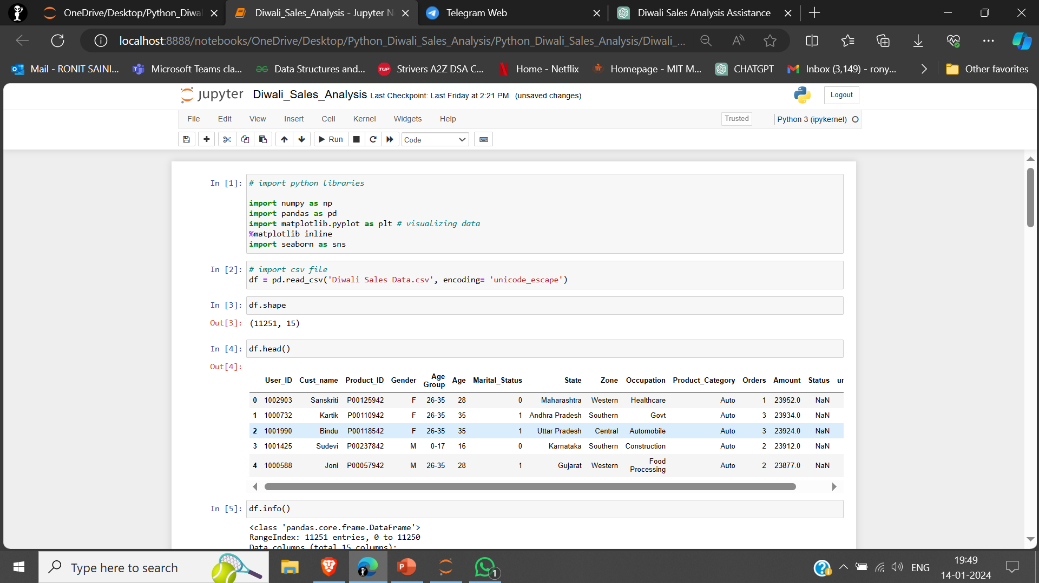
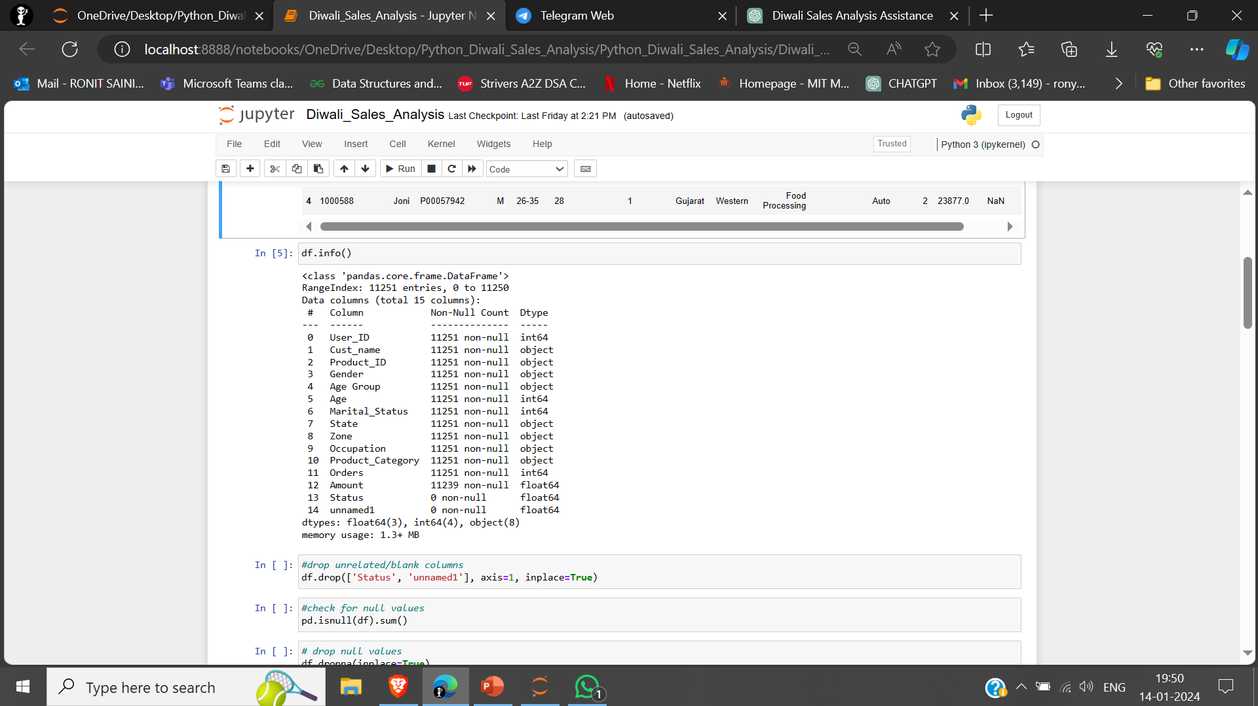

Slide 10
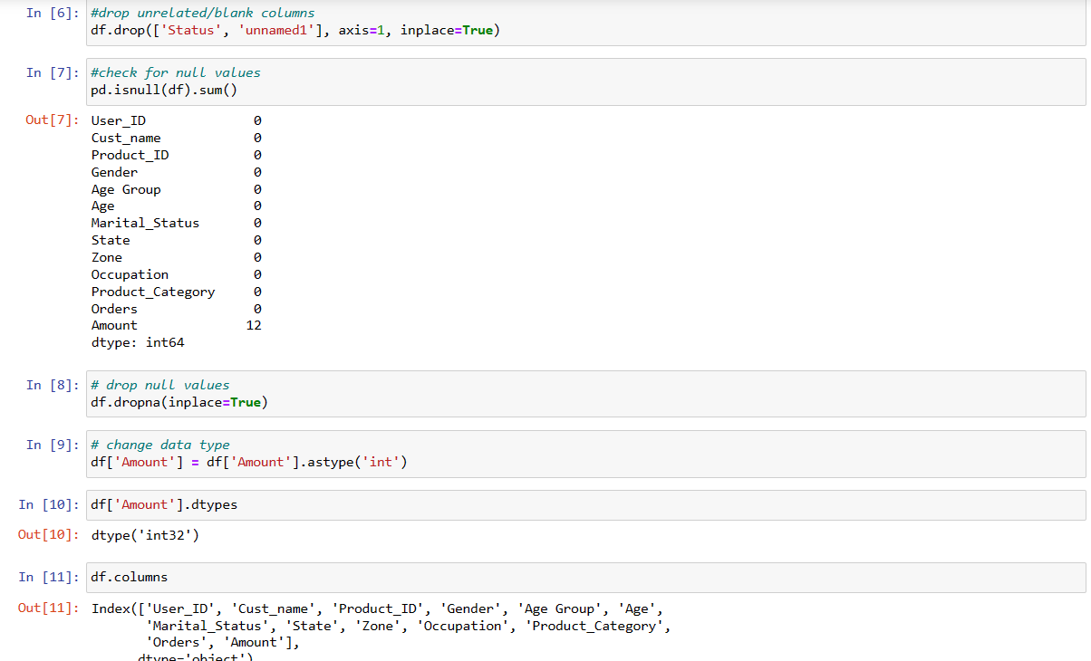

Slide 11
Descriptive Statistics:
Obtained descriptive statistics for the entire dataset using df.describe().
Used df[['Age', 'Orders', 'Amount']].describe() for specific columns.
Visualization:
Utilized various visualization techniques to gain insights:
Plotted a bar chart for gender distribution using sns.countplot.
Created a bar chart for gender vs. total amount using sns.barplot.
Visualized age group distribution using sns.countplot.
Generated a bar chart for total amount vs. age group using sns.barplot.
Analyzed the total number of orders and sales from the top 10 states using sns.barplot.
Occupation and Product Analysis:
Conducted EDA on customer occupations and product categories, using count plots and bar charts.
Product ID Analysis:
Explored the top 10 most sold products using - df.groupby('Product_ID')['Orders'].sum().nlargest(10).sort_values(ascending=False).plot(kind='bar').

Slide 12
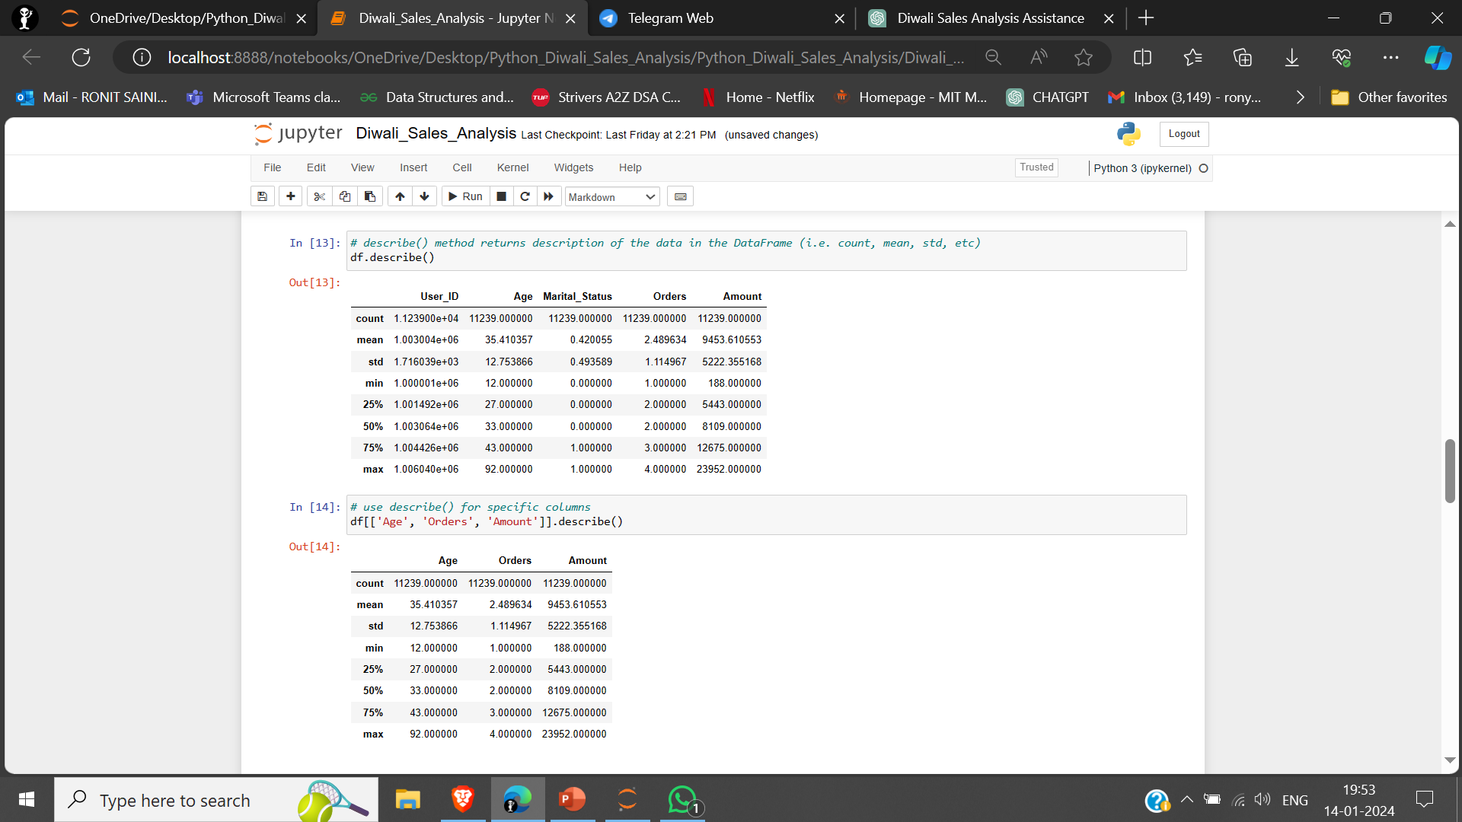
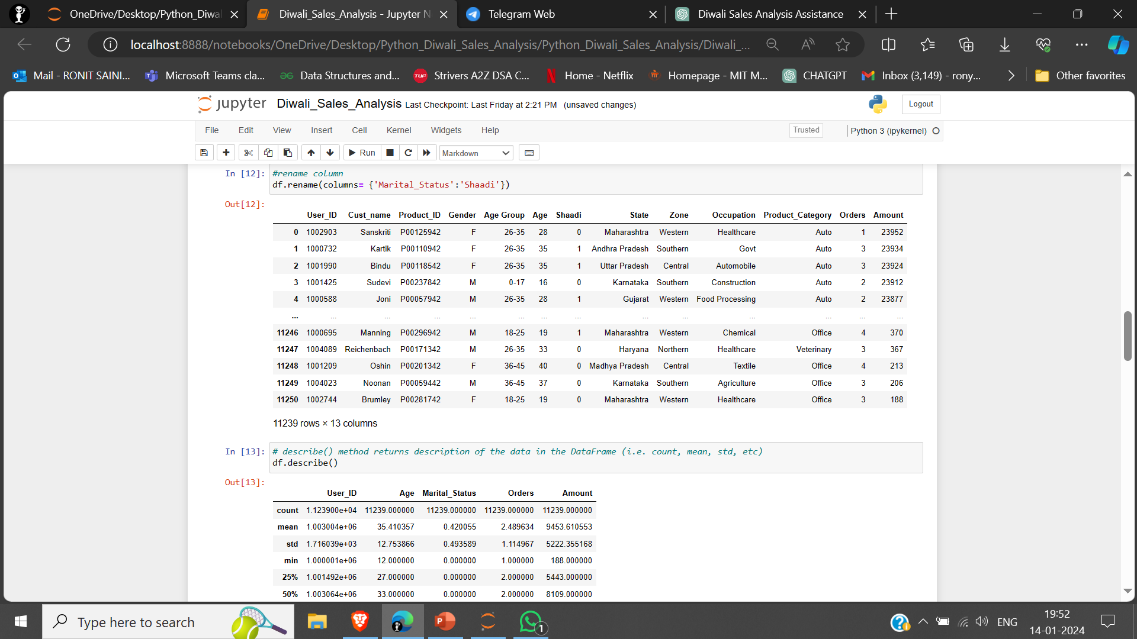

Slide 13
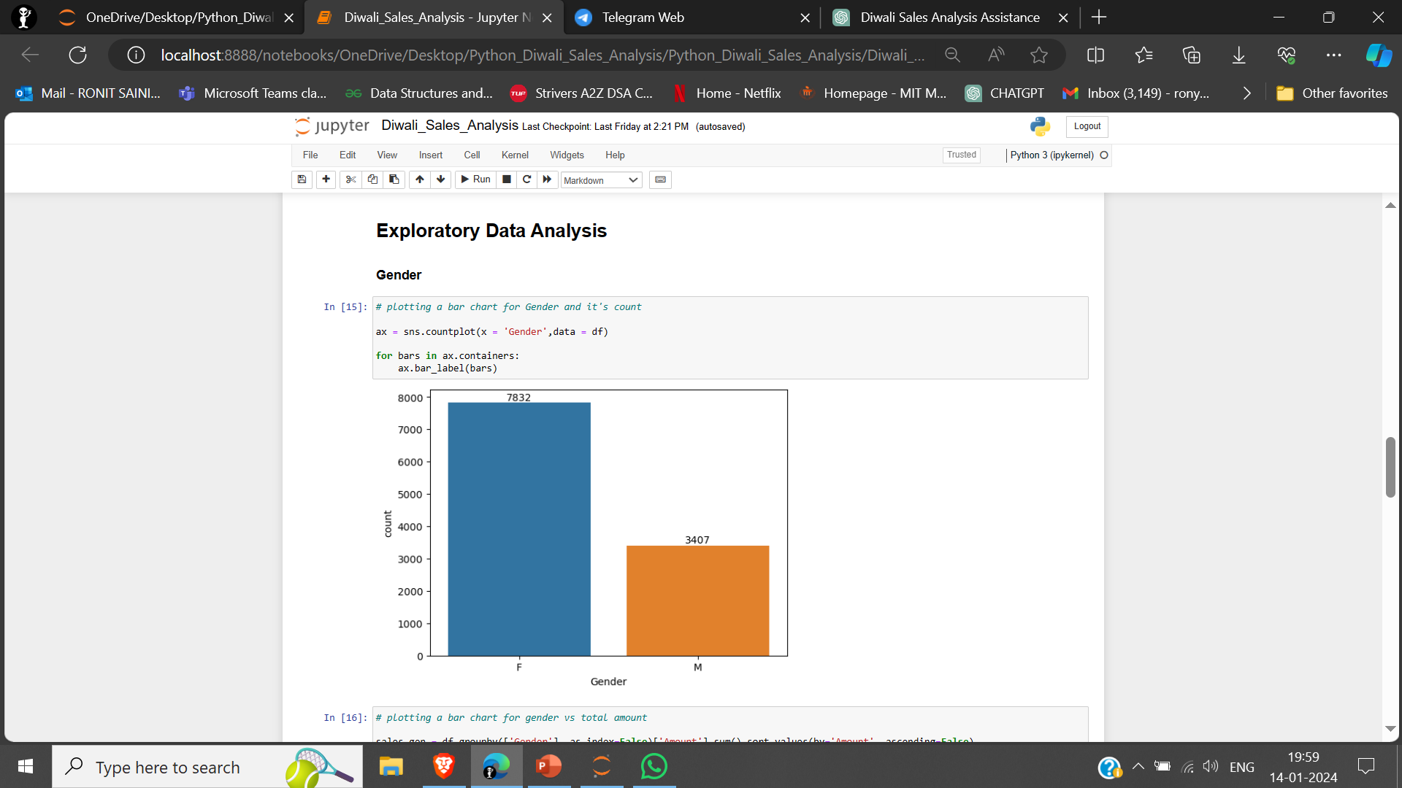
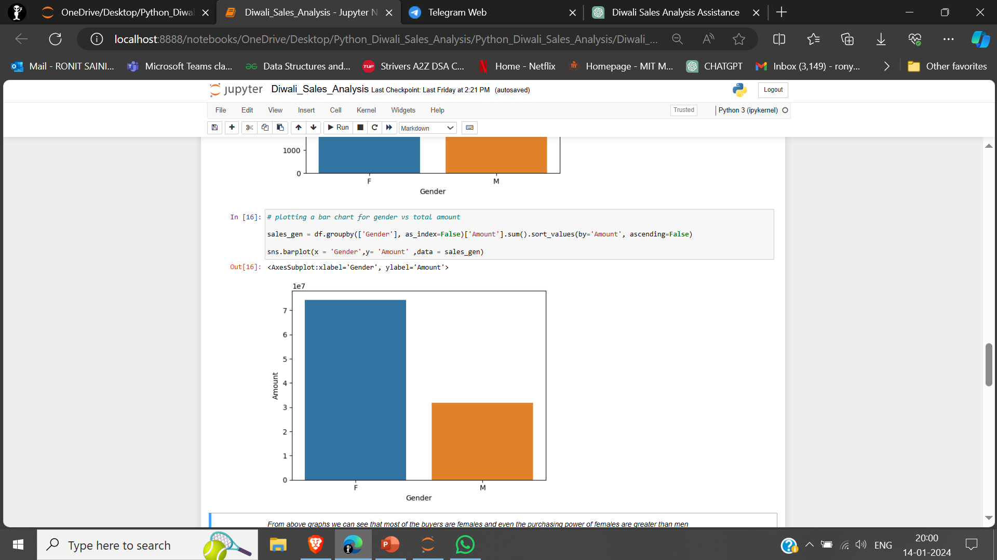
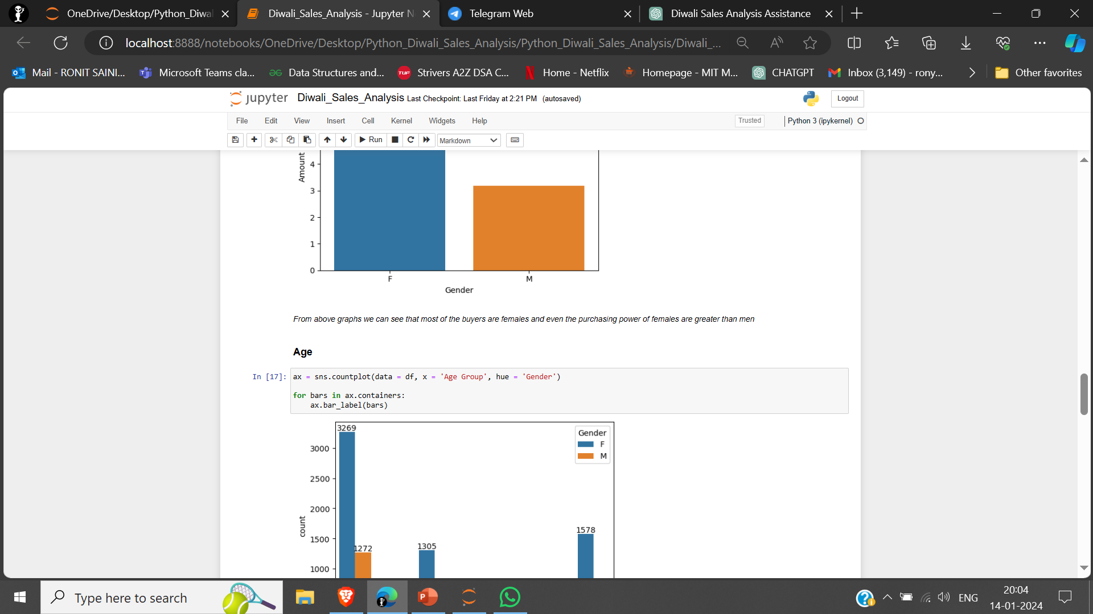
Result
BASED ON GENDER

Slide 14
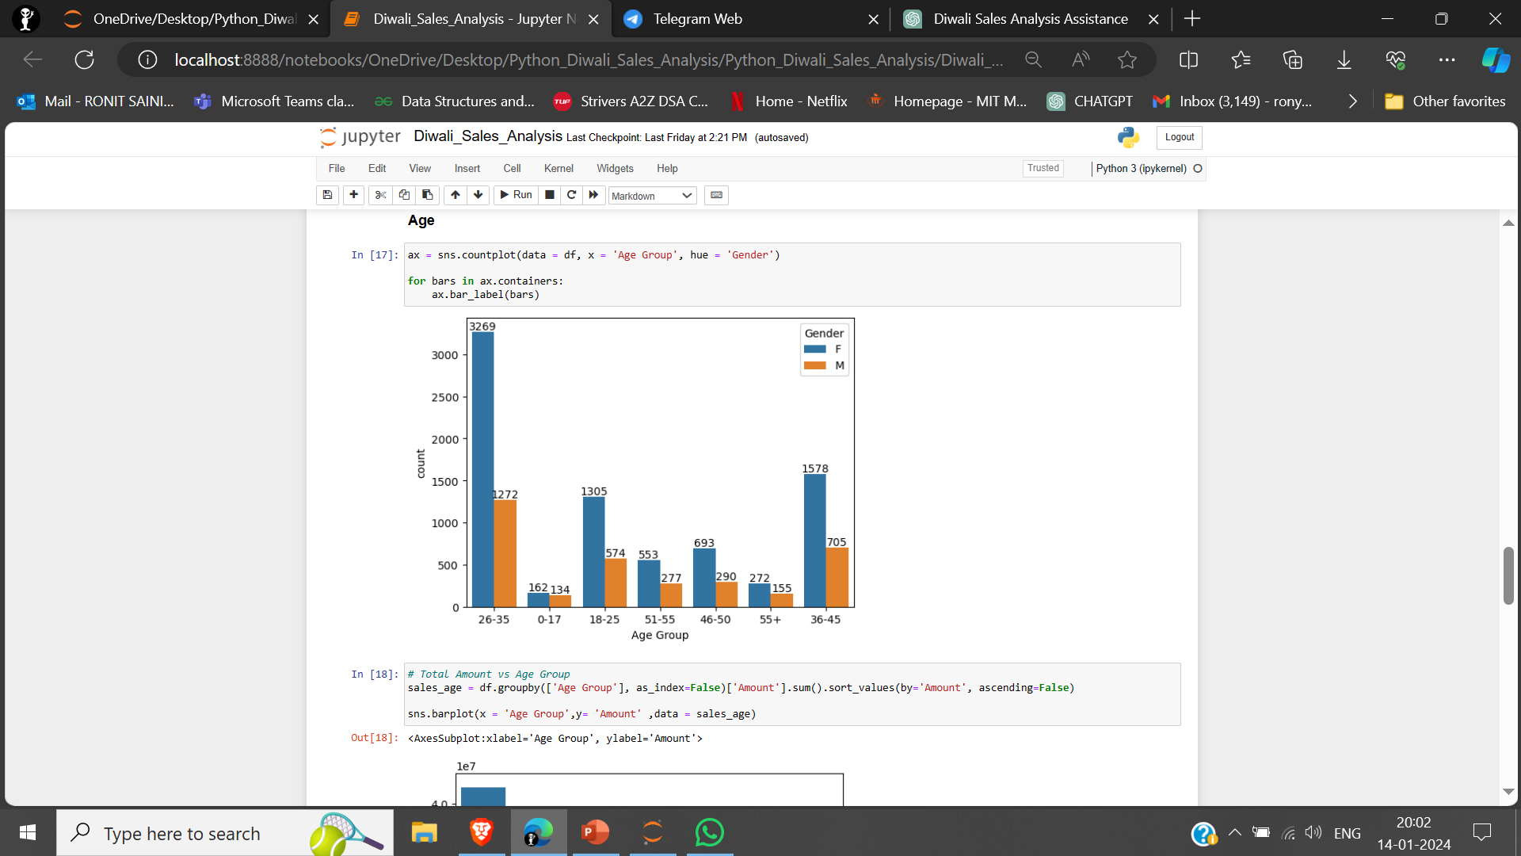
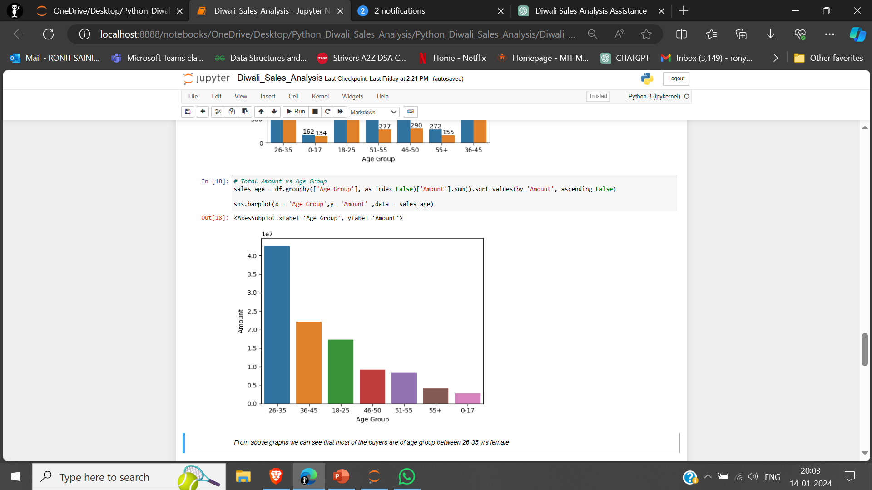
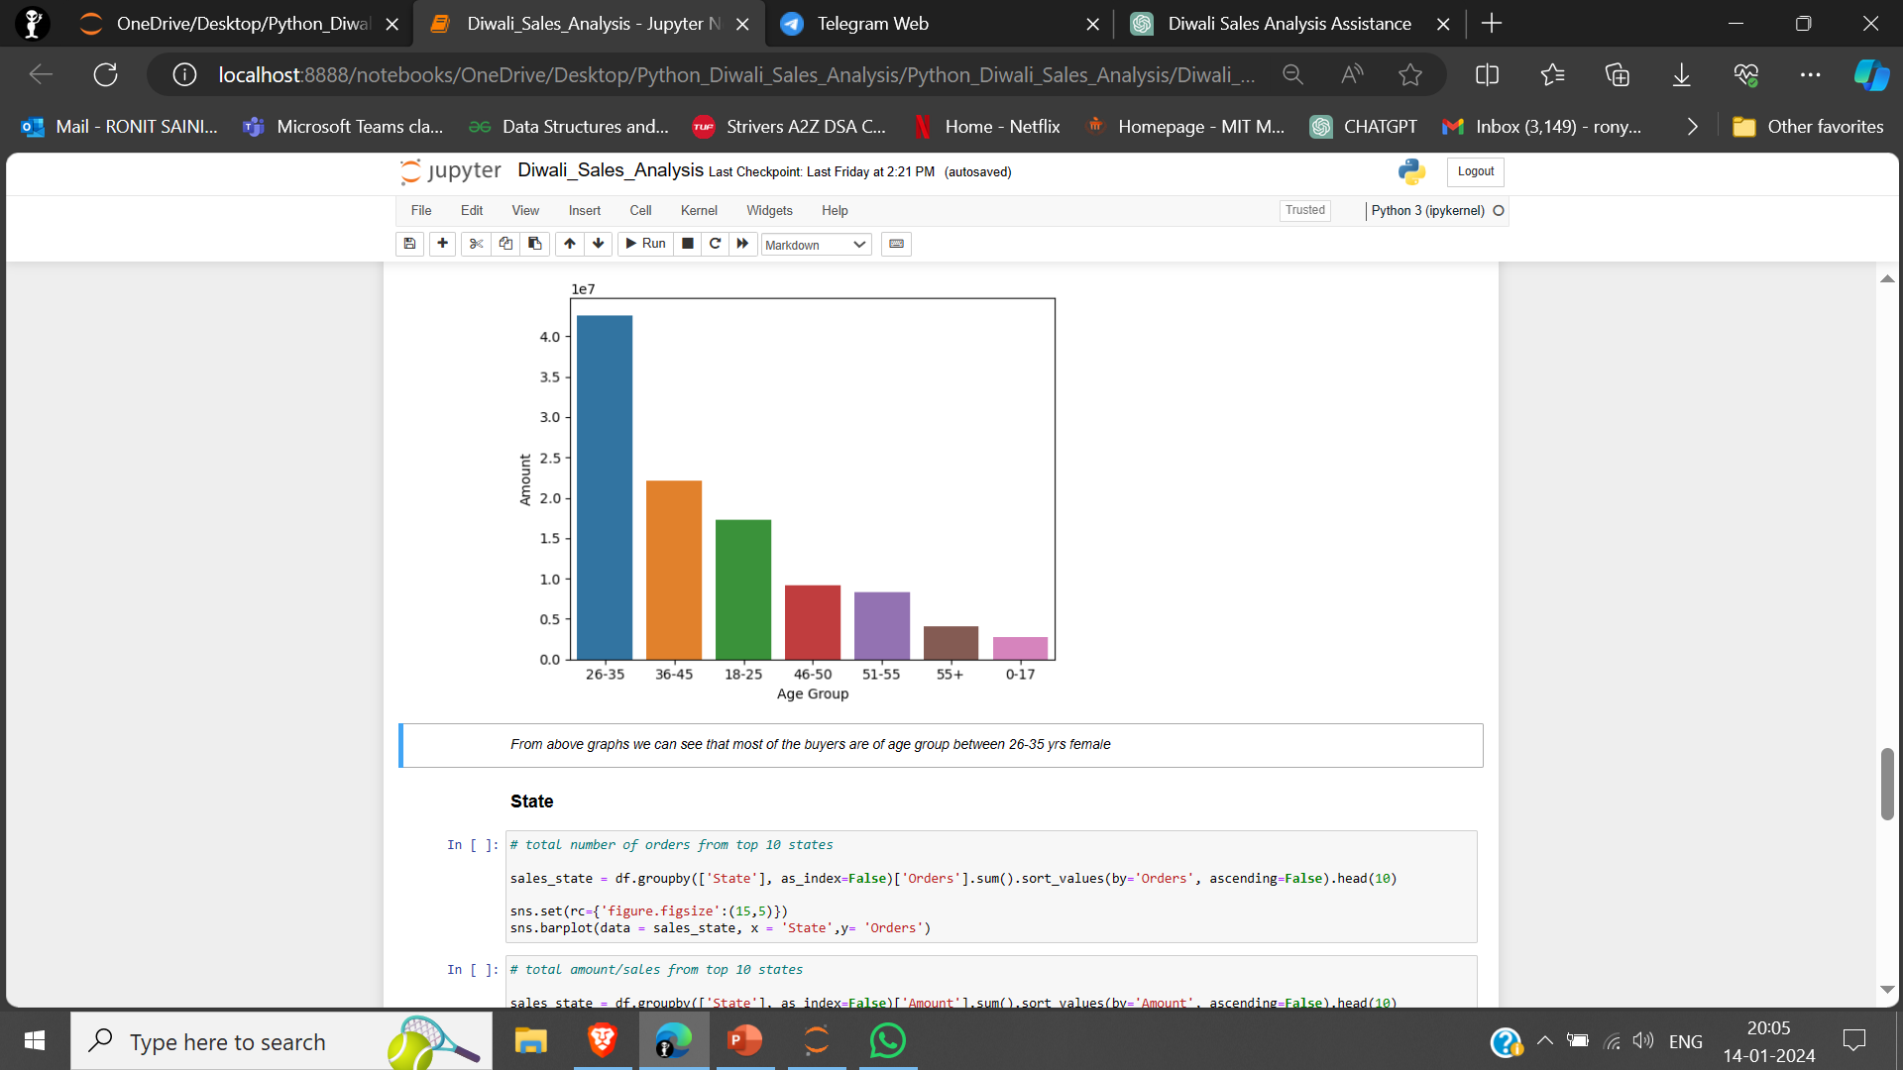
BASED ON AGE

Slide 15
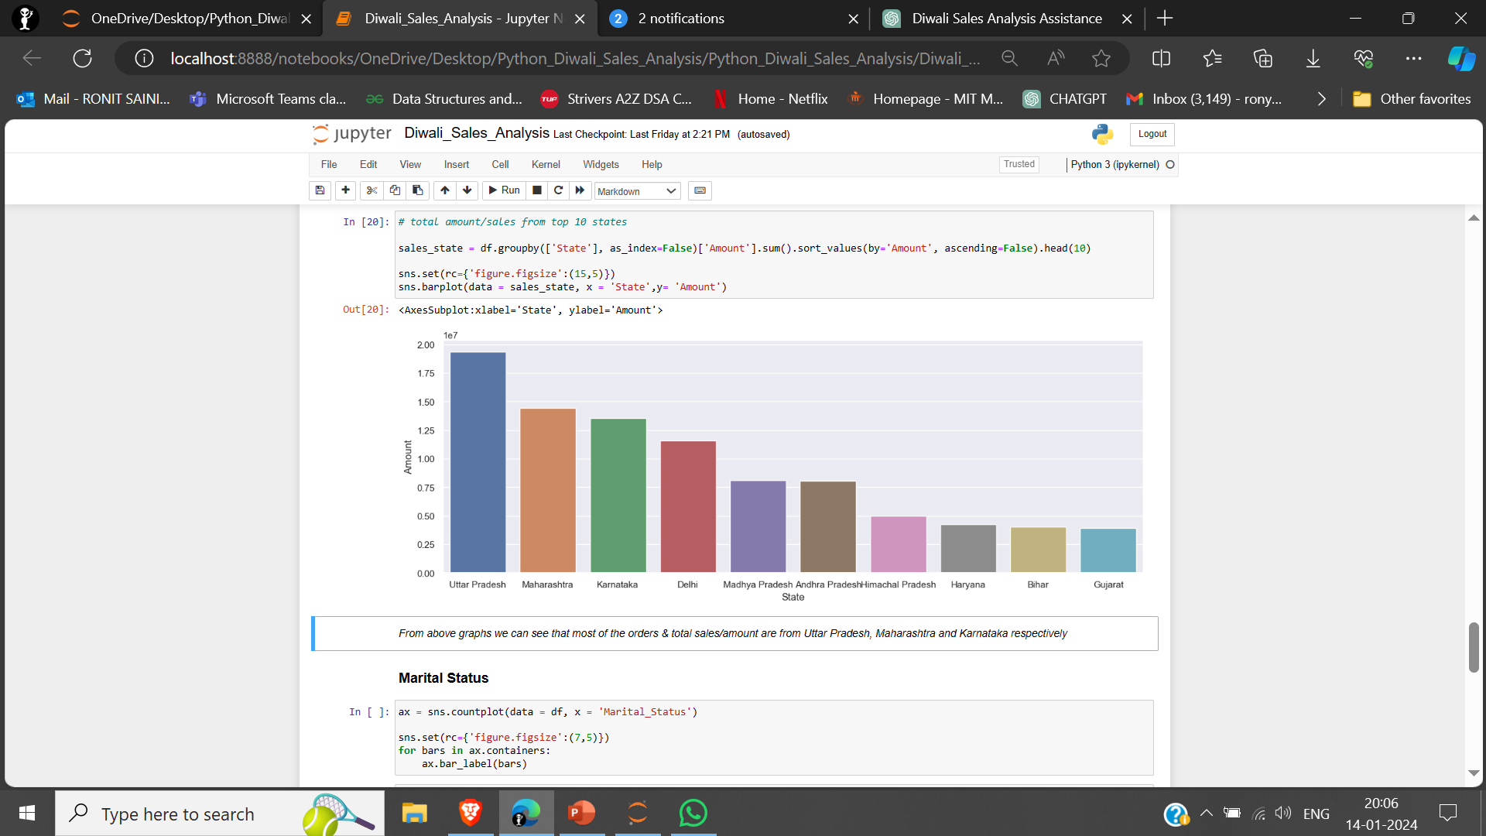
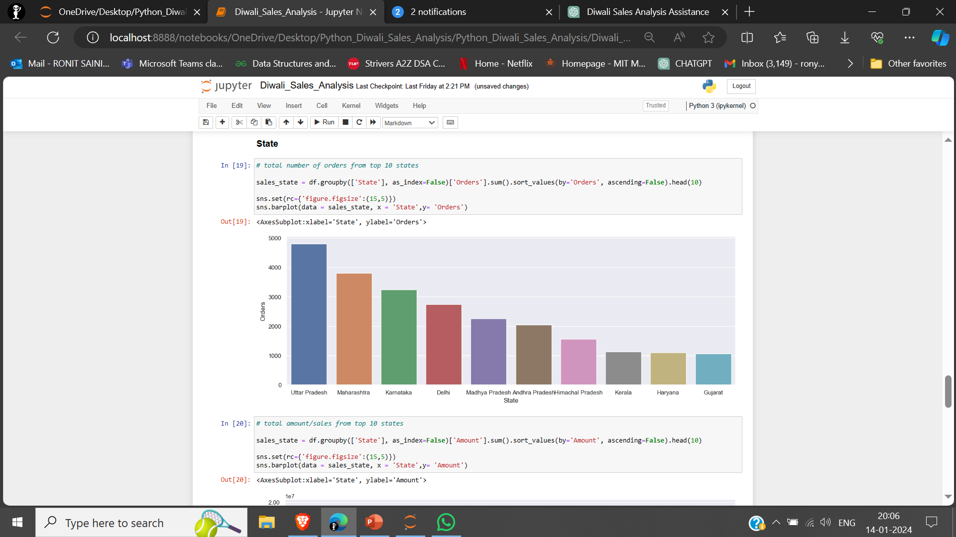
BASED ON STATE
From the graphs we can see that most of the orders and
total sales/amount are from Uttar Pradesh, Maharashtra
and Karnataka respectively.

Slide 16
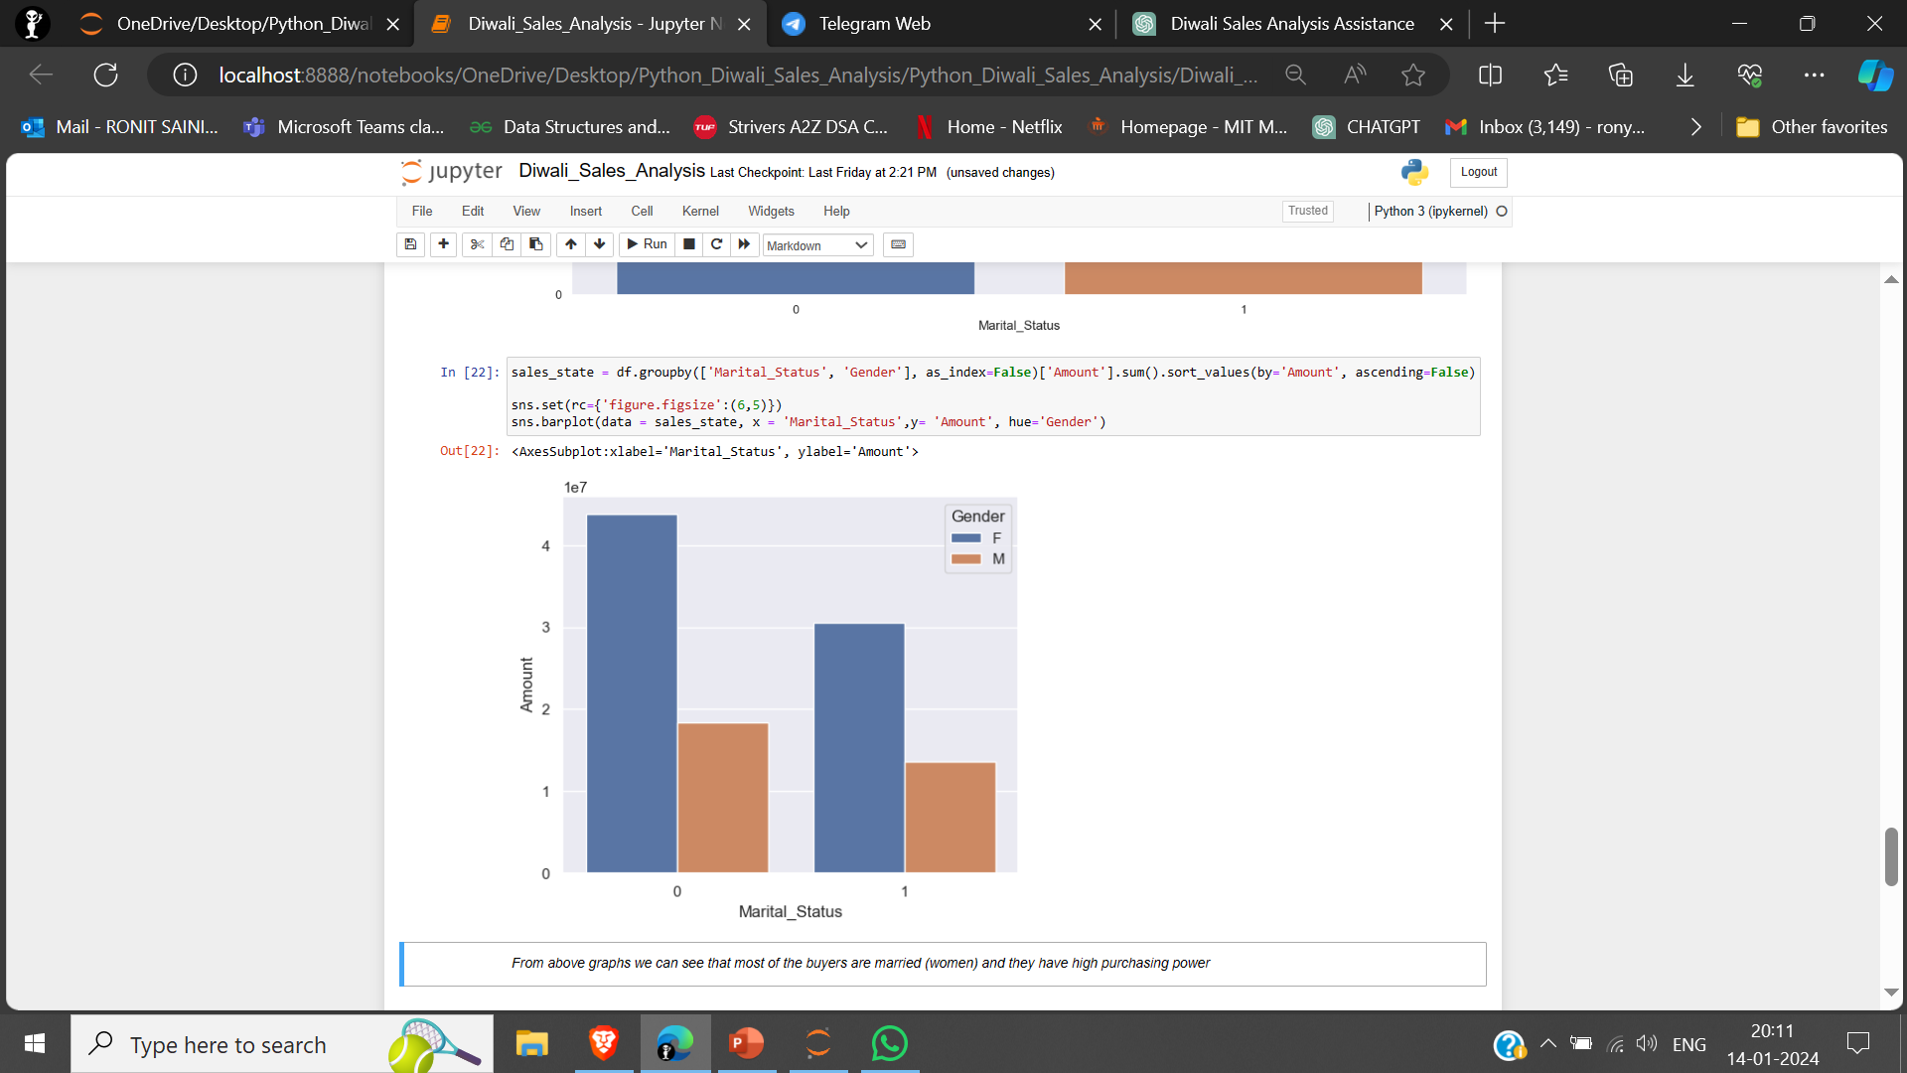
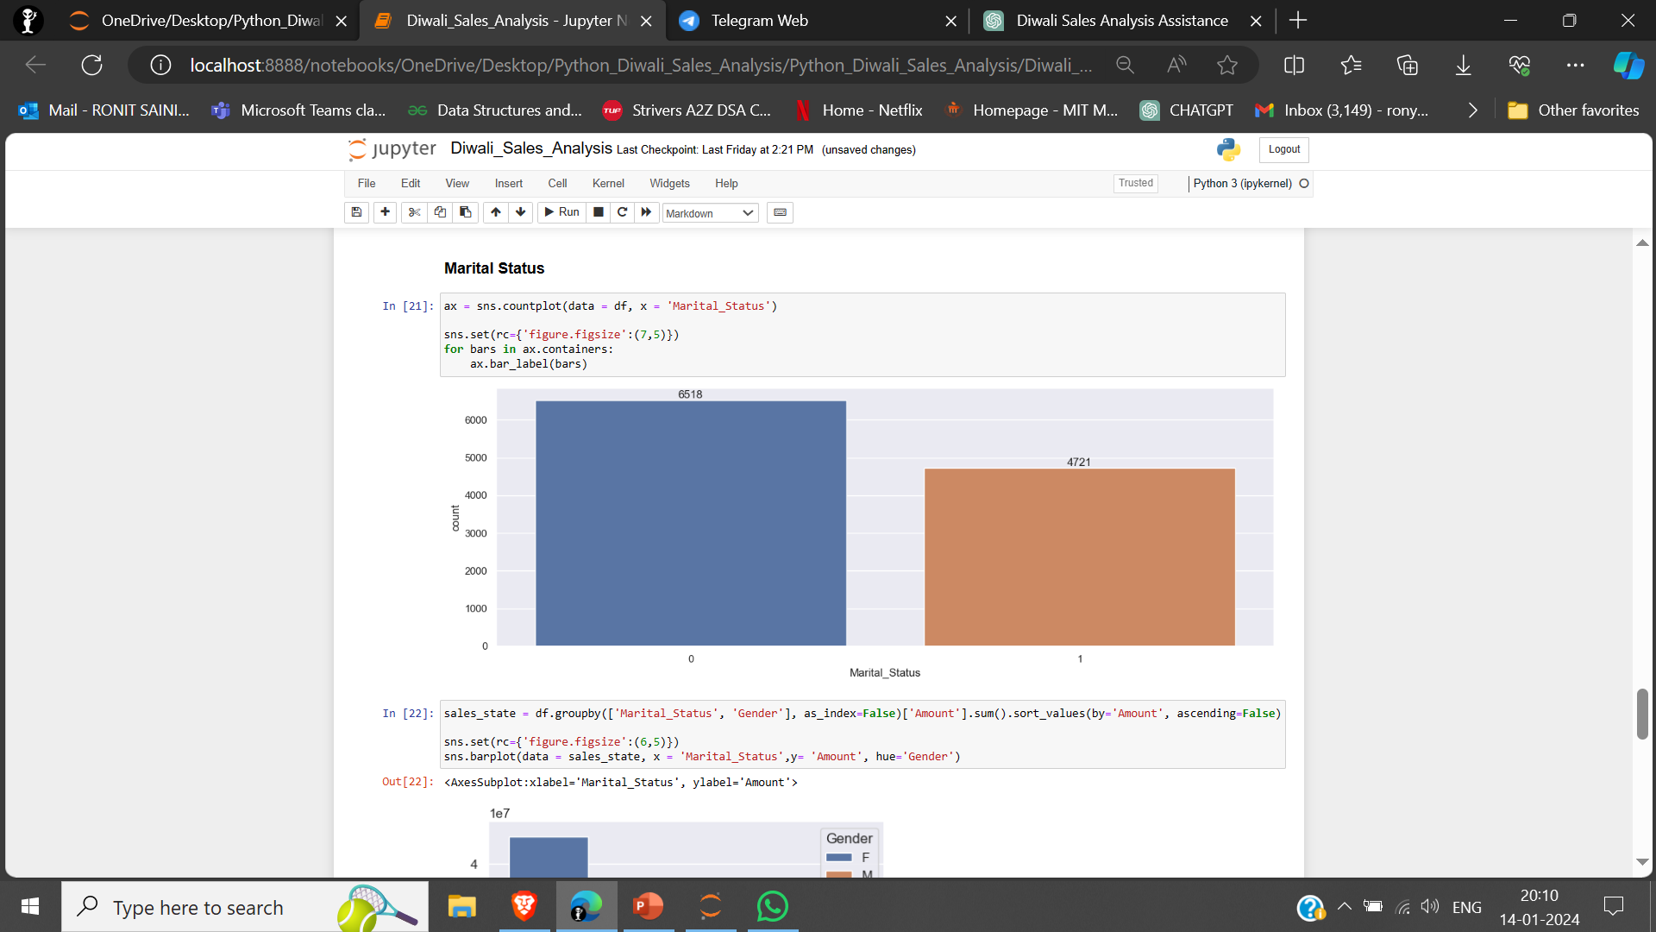
BASED ON MARITAL STATUS
From these graphs we can see that most of the buyers
are married women and they have high purchasing power

Slide 17
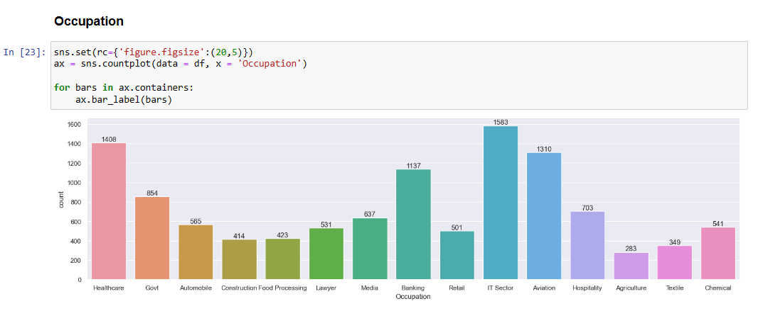
BASED ON OCCUPATION

Slide 18
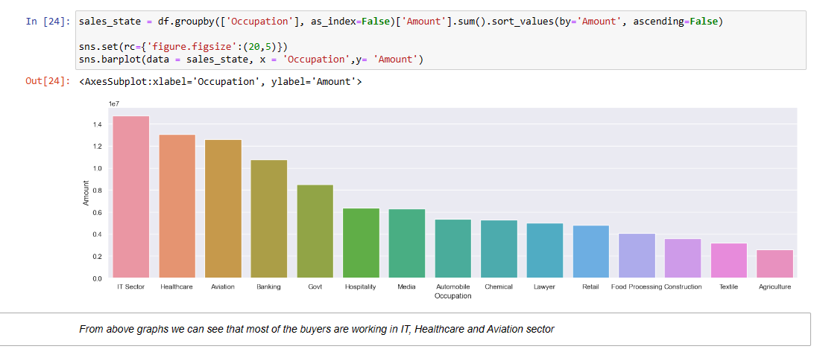

Slide 19
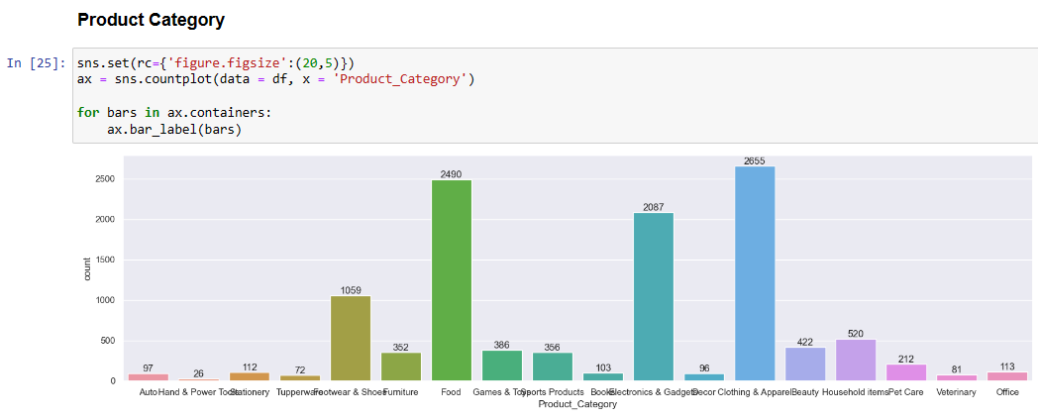
BASED ON PRODUCT CATEGORY

Slide 20
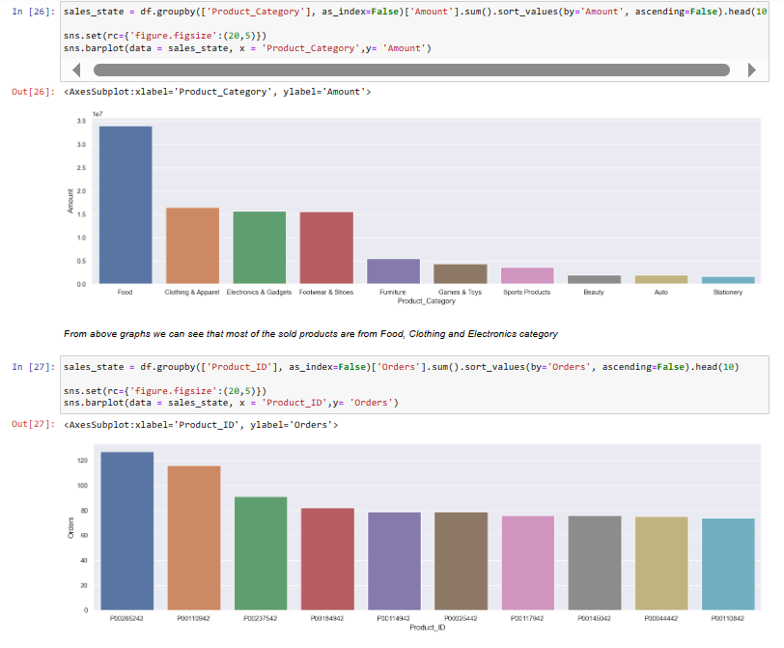

Slide 21
Conclusion
From above graphs we can see that most of the buyers are females and even the purchasing power of females are greater than men
From above graphs we can see that most of the buyers are of age group between 26-35 yrs female
From above graphs we can see that most of the orders & total sales/amount are from Uttar Pradesh, Maharashtra and Karnataka respectively
From above graphs we can see that most of the buyers are married (women) and they have high purchasing power
From above graphs we can see that most of the buyers are working in IT, Healthcare and Aviation sector
From above graphs we can see that most of the sold products are from Food, Clothing and Electronics category
After evaluating all the various demographics, I come to a final conclusion that Married women age group 26-35 yrs from UP, Maharastra and Karnataka working in IT, Healthcare and Aviation are more likely to buy products from Food, Clothing and Electronics category

Slide 22
Effectiveness of the Proposed Solution:
The proposed solution has proven effective in providing a holistic understanding of Diwali sales dynamics. The systematic approach, involving data collection, demographic analyses, regional insights, and marketing strategies, has equipped businesses with actionable intelligence for optimizing sales strategies. The use of visualizations enhances communication, enabling stakeholders to grasp critical insights easily.
Potential Improvements:
Predictive Modeling: Incorporate machine learning models for sales forecasting.
Real-Time Data: Integrate real-time data sources for up-to-the-minute insights.
User Interface: Develop a user-friendly interface for stakeholders to interact with and explore the data.
Importance of Accurate Sales Analysis:
Accurate sales analysis is pivotal for strategic decision-making. It not only guides marketing efforts but also aids in inventory management, resource allocation, and overall business planning. The Diwali Sales Analysis showcases the significance of understanding customer behavior and market trends, underlining its role as a fundamental tool for businesses aiming to thrive in dynamic markets.
In conclusion, the Diwali Sales Analysis project has provided a solid foundation for informed decision-making, and continual improvements can further elevate its effectiveness in optimizing business strategies during the festive season.

Slide 23
References
Kaggle : Diwali Fastival Sales Data Analysis | Kaggle
Driving Diwali Success: The Impact of Big Data Analytics on E-commerce Sales | by Aclysis | Medium
For future scope : Diwali Sales prediction using machine learning (jetir.org)

Slide 24
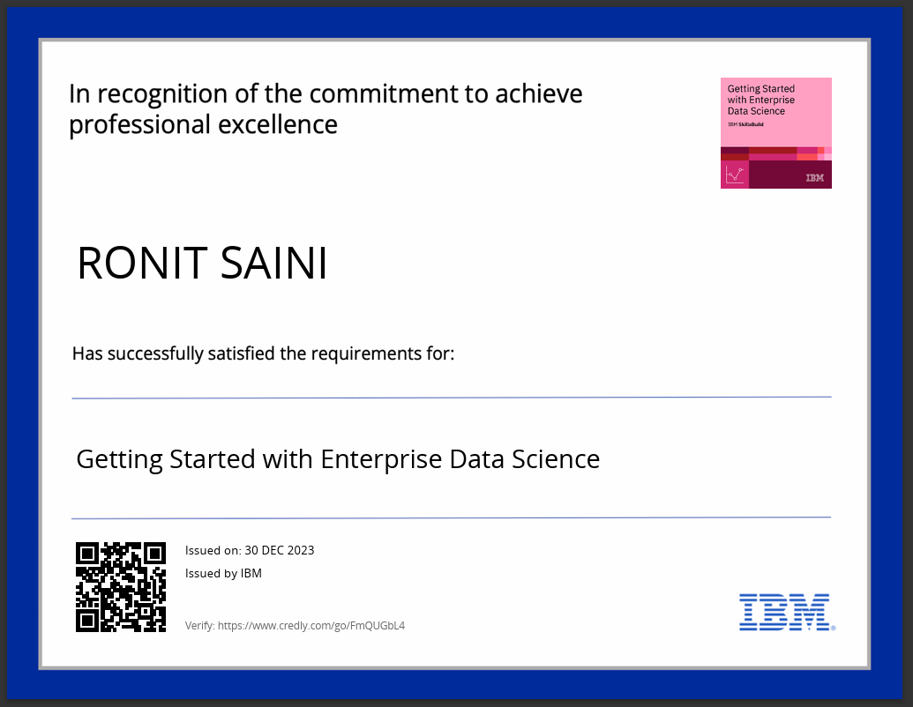
course certificate 1

Slide 25
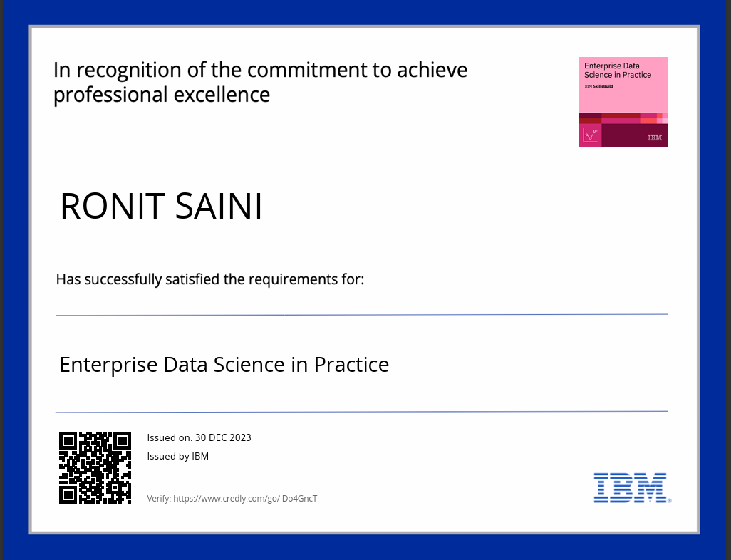
course certificate 2

Slide 26
THANK YOU

